Slide 1
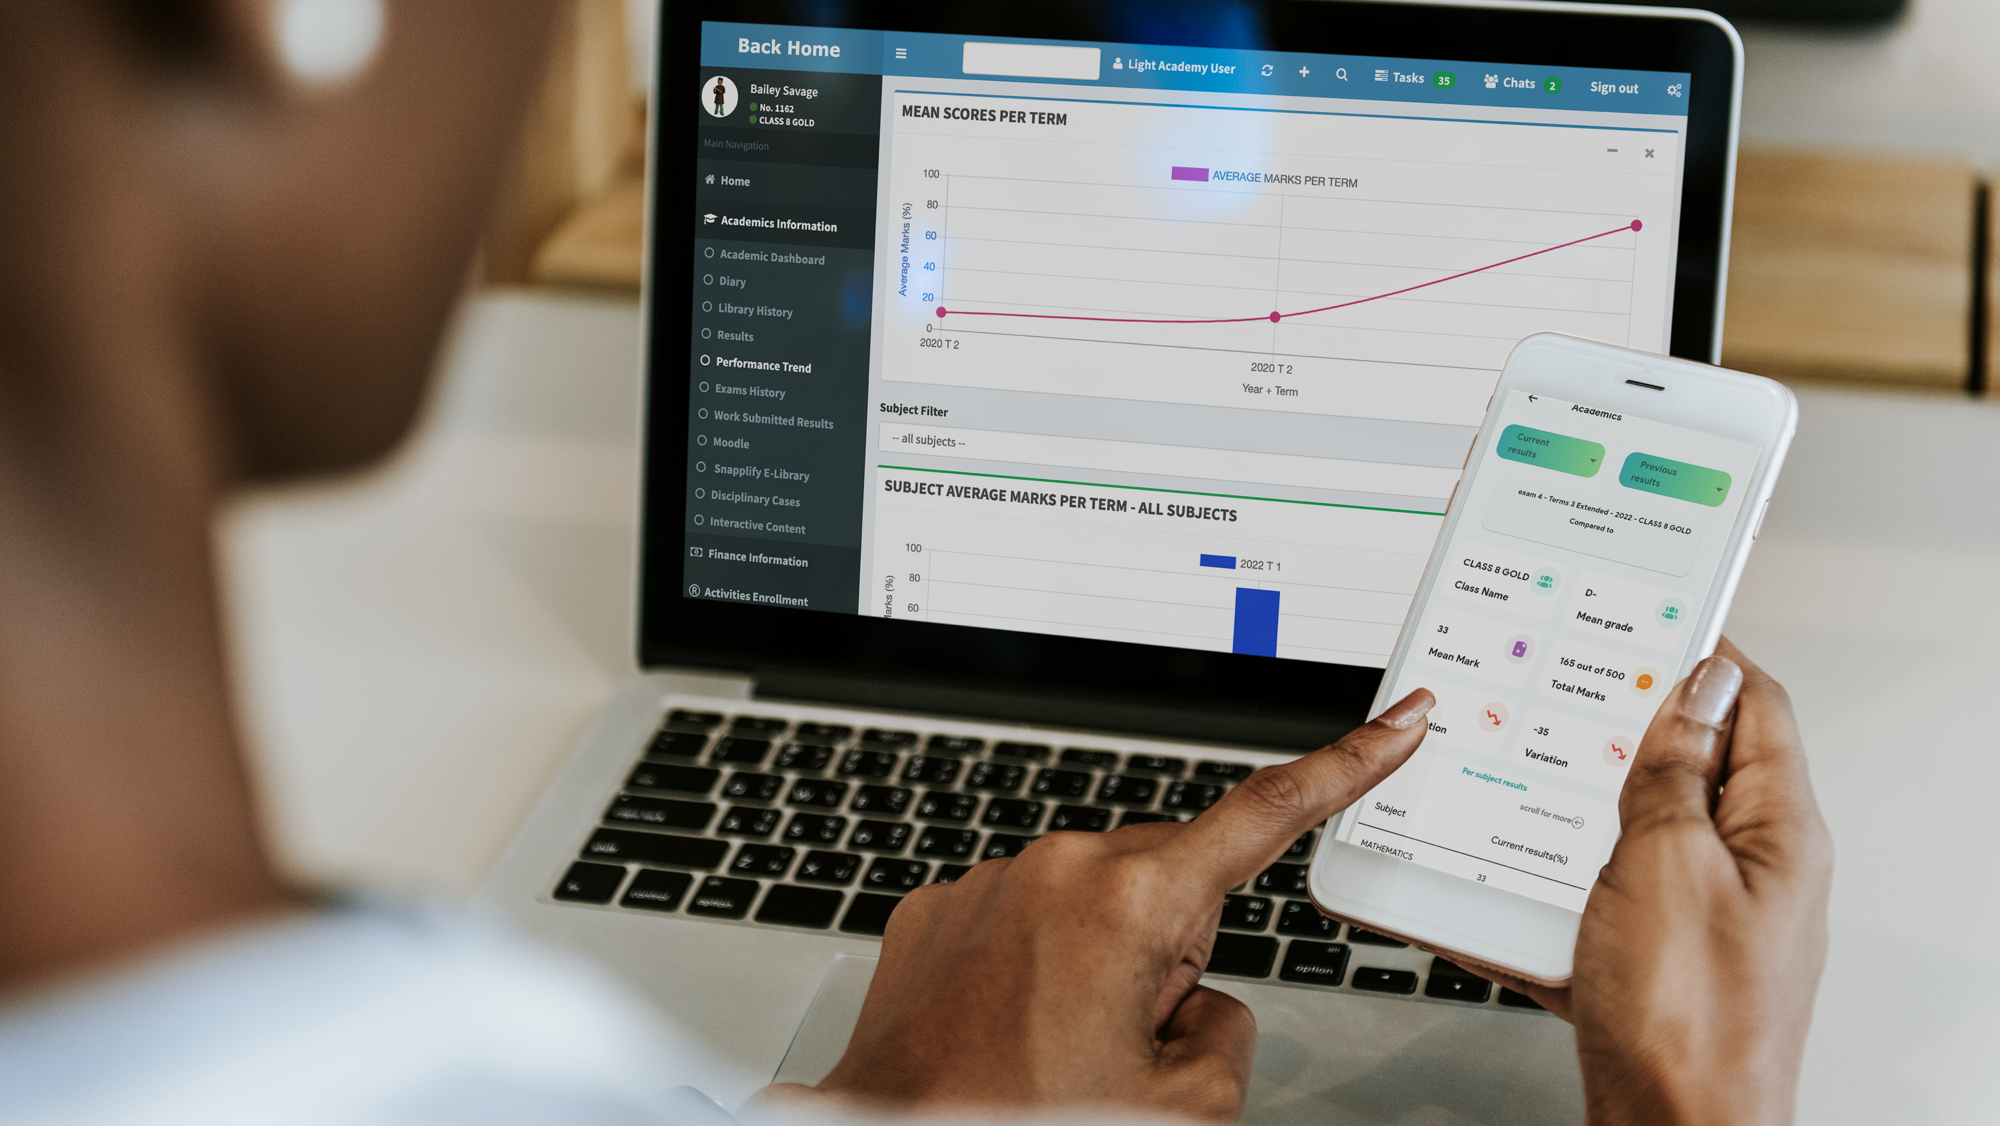
In partnership
with

Slide 2
Problem Statement

Slide 3
Financial Operations
We help automated the financial process nightmares in student Invoicing, collection automation, and reporting automation
We help answer the Question on issues on:-
How is to be given a gate pass?
What is the fee payment ratio by class?
Can we feed the children today and how many?

Slide 4
Teacher Learning Assessment
We help reduce the time taken by a teacher in student attendance recording, assessment management and performance analysis.
We help answer the Question on issues on:-
What is my attendance rate today, the week, the month the term ?
How many students are lagging behind in my class and what engagement can we introduce to improve this state?
How is our school performing in CBC in line with KICD curriculum?

Slide 5
Parent involvement in Student learning
We help bring the parent at the center of the learner education for both Financial and Academic activities.
We help answer the Question on issues on:-
How do we incorporate home learning by learner by having digital diary?
How is my child performing in this exam vs last term vs previous years?
Can I reduce the inconveniences in paying fees?

Slide 6
Overall Benefits
PARENTS
KCB
EDUCATION INSTITUTION
Saves Time
Easy to use
Pay from anywhere and anytime at your convenience
Realtime feedback
Proof of payment
Full student itinerary (timetables)
Easy access to the admin communication/results
Easy enrollment/application
Partial payment facility
Increase of bank deposits
Acquisition of new schools/universities
Increase of KCB brand awareness
Realtime transaction monitoring
Reduce manhours required by the bank tellers
Easy cash management
Fees are directed to the KCB bank A/c
Proof of payment
Real time transaction monitoring

Slide 7
Who we are
STATISTICS
Schools Onboard : 300+
Student Population: 200,000 +
Mzizi School ERP, by Ultratude Tech Ltd, is a Kenyan-made end-to-end school management system designed to revolutionize school operations. Our goal is to boost efficiency, simplify daily tasks, and secure crucial educational data. From managing admissions and finances to facilitating communication and administration management.
Mzizi offers a comprehensive suite of features with different package options to cater for diverse school needs, making it a versatile solution for the school ecosystem.

Slide 8
Our Clientelle

Slide 9
Mzizi – KCB Partnership Solution
We help improve the deposits channeled to the bank and improve collections
We help answer the Question regarding:-
How many schools come for a loan and do not qualify?
How many do not qualify due to undocumentation?
How many schools lack access to credit?
How many schools close with a high debt hence auctioning?

Slide 10
The Benefits of The Partnership
We help improve the deposits channeled to the bank and improve collections
We help answer the Question on issues on:-
How many schools come for a loan and do not qualify?
How many do not qualify due to undocumentation?
How many schools lack access to credit?
How many schools close with a high debt hence auctioning?

Slide 11
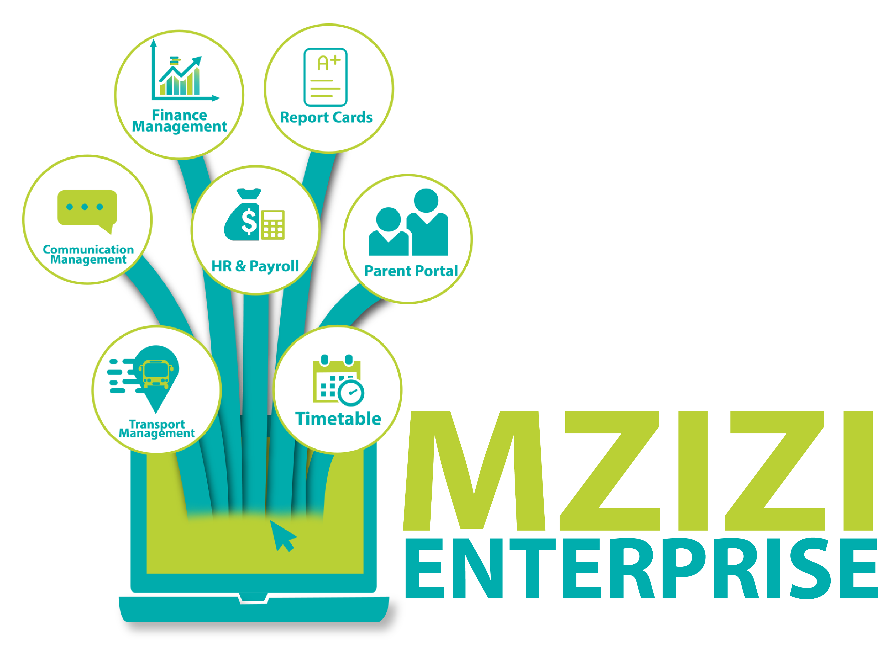
Mzizi Parent Portal

Slide 12
How it Works
Schools get Mzizi ERP for student automation for both operations and Assessment
Parents and Students access academic and financial information from a mobile and web app.
Parents and Students access academic and financial information from a mobile and web app.

Slide 13
The Parent and Student
Online Learning
Interactive books - LoHo Learning
Interactive content - msingipack
Financial Service
Academic Assessment

Slide 14
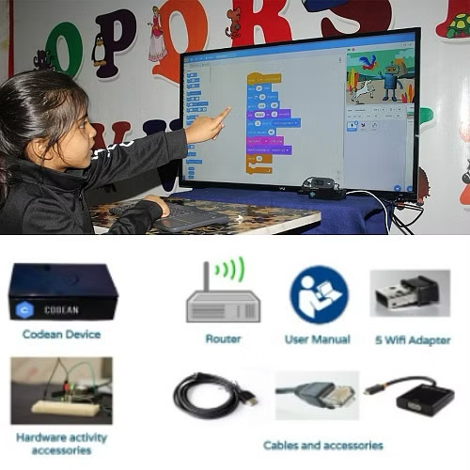
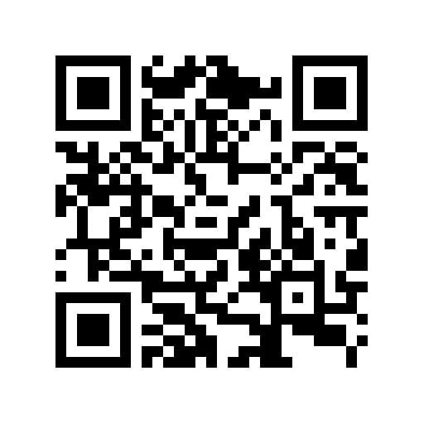
Digital Literacy Program
AR learning
Visual programming
Curriculum programming Languages
Robotics

Slide 15
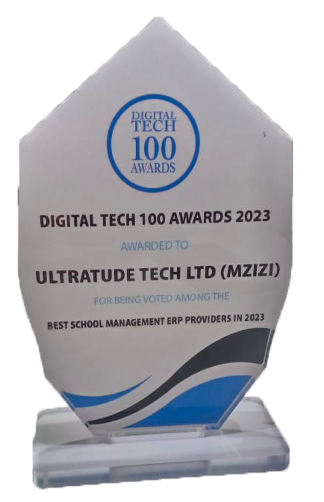
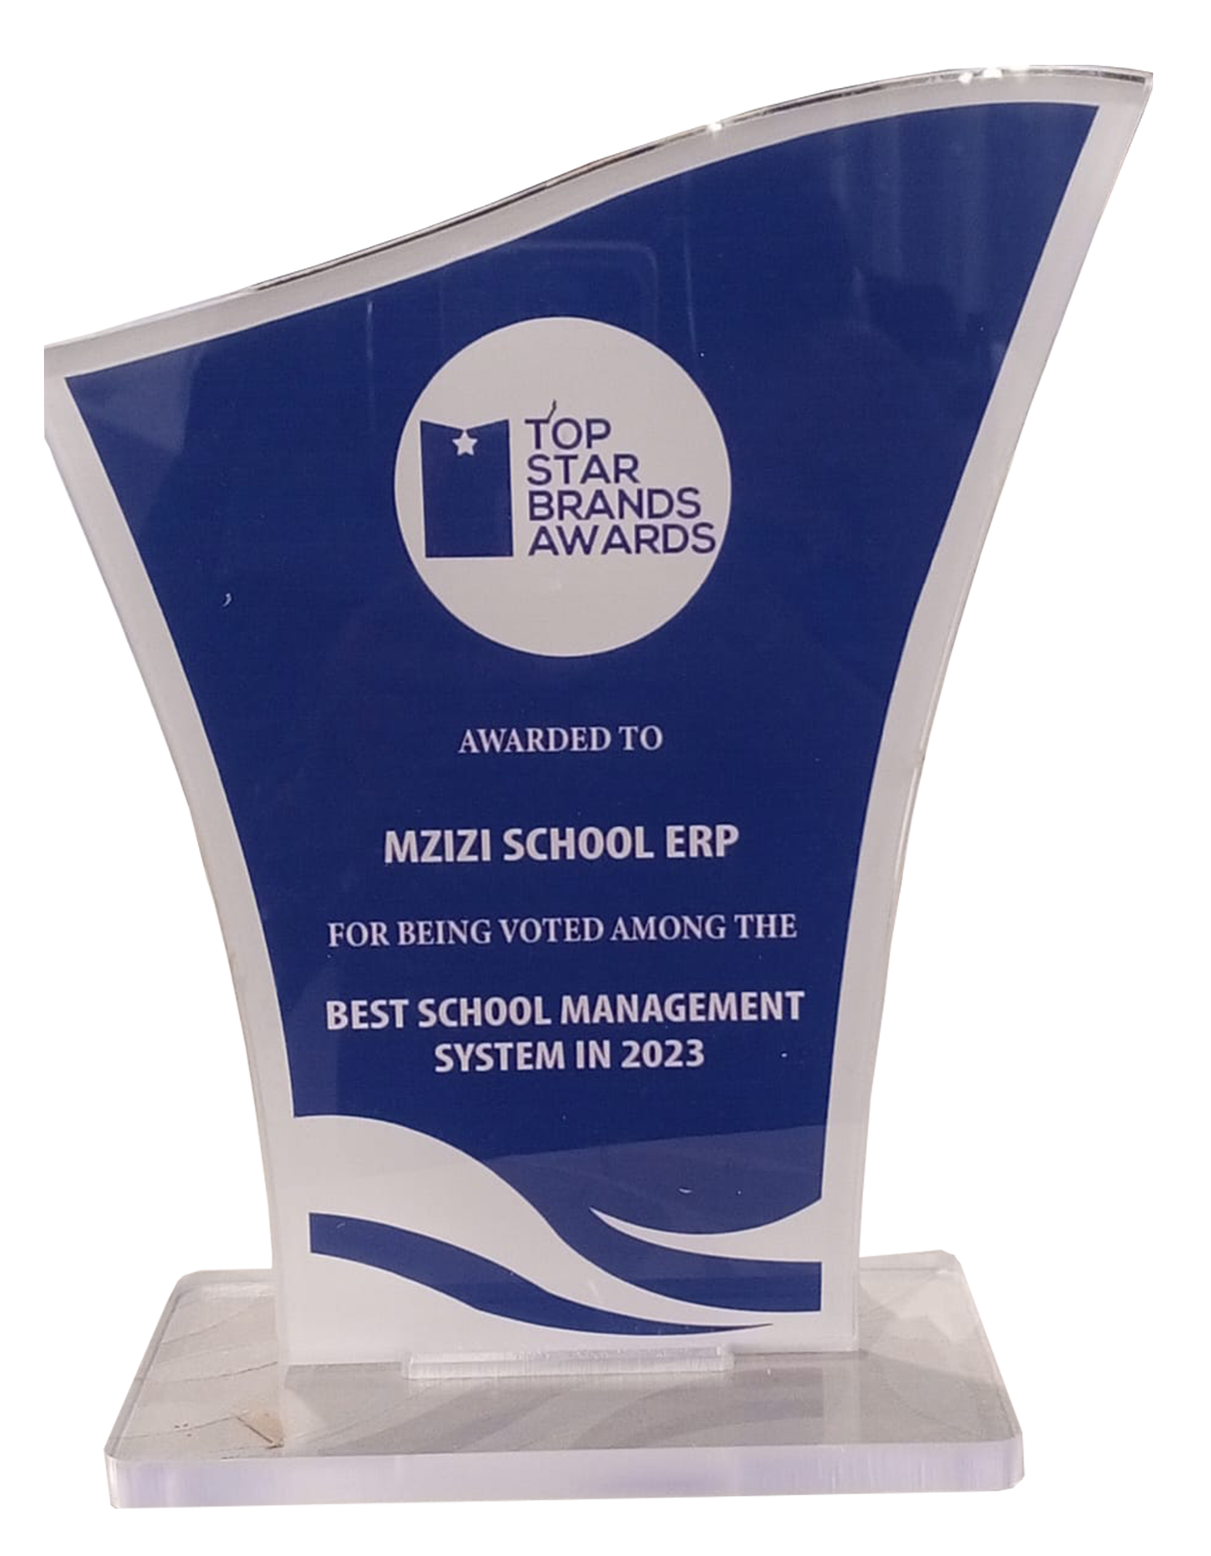
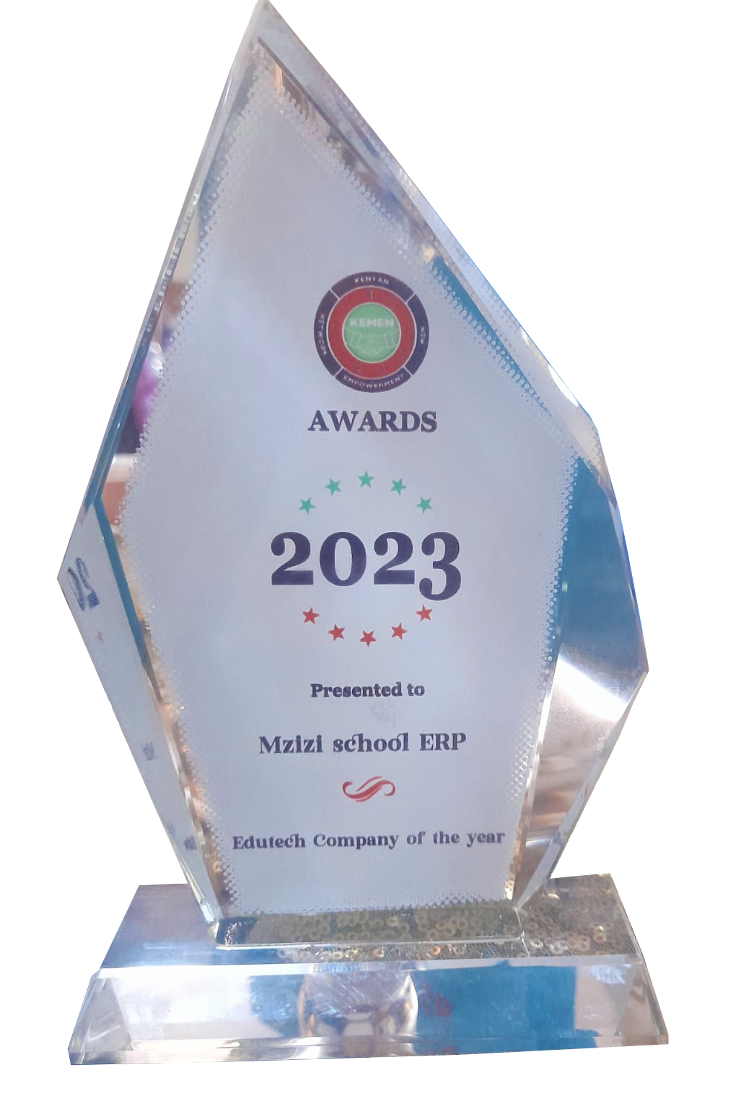
Our Achievements
In the last year, we have received three awards for the best school management system in the country. This proves that Mzizi does its absolute best to offer the best ERP systems for educational institutions.

Slide 16
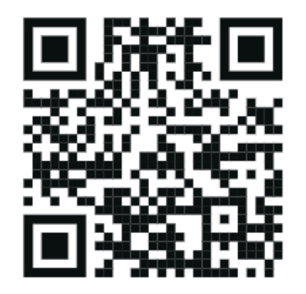
Looking Forward
to working with you
CEO - 0716 976 443
Team – 0743 513 159
www.mzizi.co.ke
hello@mzizi.co.ke

