Slide 1
Mzizi
ERP
Growing Together

Slide 2
ABOUT
US
Ultratude Tech Ltd
We’ve carved a niche in the education sector by providing solutions that transform how institutions work.
We provide a unique collaboration experience for different stakeholders in the value chain.
Our product, Mzizi ERP, tackles a wide array of challenges faced by schools in their day to day operations.
Formed in 2010, Ultratude Tech was formed to change the narrative of education software.

Slide 3
THE SYSTEM

Slide 4
CORE Offering
Mzizi Bursar Pack
Mzizi Teacher Pack
Provides the ability manage :-
Student Management; Student Payment; Student Invoicing; Automated payment( via Tingg ); Reporting and Communication .
Provides the ability manage :-
Student Management; CBC Curriculum ; 8.4.4 Curriculum; Discipline management; Attendance management, Duty Rooster, Academic reporting
Mzizi Addons ( Operations)
Communication
The below are additional services available on Need Basis:-
Mzizi HR System ; Mzizi Procurement Management; Mzizi Accounting system Integration; Mzizi Financial Integration (Bank and Mpesa) ; Mzizi Academics Integrations, Digital Diary
Provides the ability manage :-
Bulk SMS; Bulk Email; Parent and Student Portal ; Mobile Apps

Slide 5
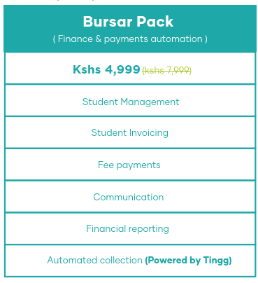
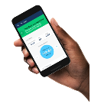
Main Service
Mzizi
Bursar Pack
Persentation Power Point
Student Management
Student Invoicing
Student Payments
Provides school multi branch management and Student management ( Prospect, Students, Siblings)
Provide ability to Manage student invoices with Multiple fee structure management, Prospect invoicing; multi-branch invoicing
Provides ability to receipt and collect fee payments; with auto communication on receipts by SMS, email and portal
INTEGRATIONS
Reporting and Communication
CLOUD BASED
Mzizi / Tingg Payment Integration – For fee collection and Debt Management
Multiple finance reports with ability to communicated by SMS | Email | Apps | Portal
Manage your data anywhere, anytime

Slide 6
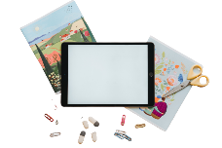
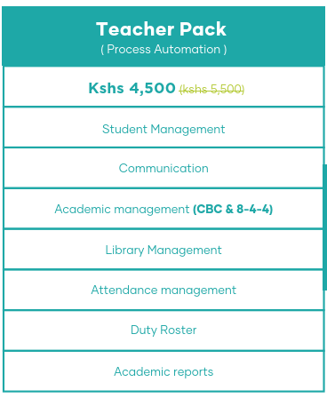
Main Service
Mzizi
Teacher Pack
Persentation Power Point
Student Management
Student Attendance
CBC and 8.4.4 Curriculums
Provides school multi branch management and Student management ( Prospect, Students, Siblings)
Provide ability to Manage student attendance based on the school timetable period or school sessions and Stafd duty rooster
Provides ability to manage CBC and 8.4.4 based on the KICD curriculum guideline
Other operations
Reporting and Communication
CLOUD BASED
Provides Displine management, library management; Terms schedule management
Multiple Academic reports with ability to communicated by SMS | Email | Apps | Portal
Manage your data anywhere, anytime

Slide 7
THE PROCESS

Slide 8
OUR METHODOLOGY
PROJECT INITIATION
Project is a self sign on system
Provides system Terms and Condition
Data Templates Population
3
Days
SYSTEM CONFIGURATION & TRAINING
Data Loading
Staff Training
POST IMPLEMENTATION SUPPORT
Handover Process
Click to Download
Data Importation Template
Terms and Conditions

Slide 9
Sample Screenshots and Sample reports

Slide 10
Sample Finance and Academics Report
Academics Sample Reports
Finance Sample Reports

Slide 11
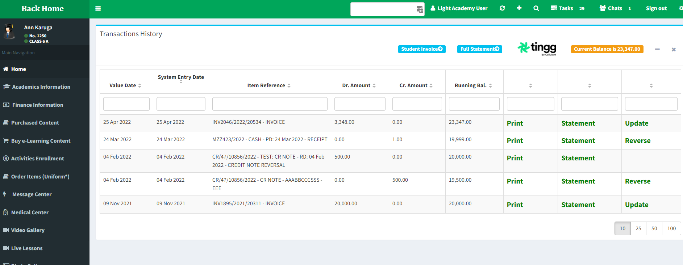
The Invoicing
Mzizi provides student invoicing capabilities with reporting at parent portal and App

Slide 12
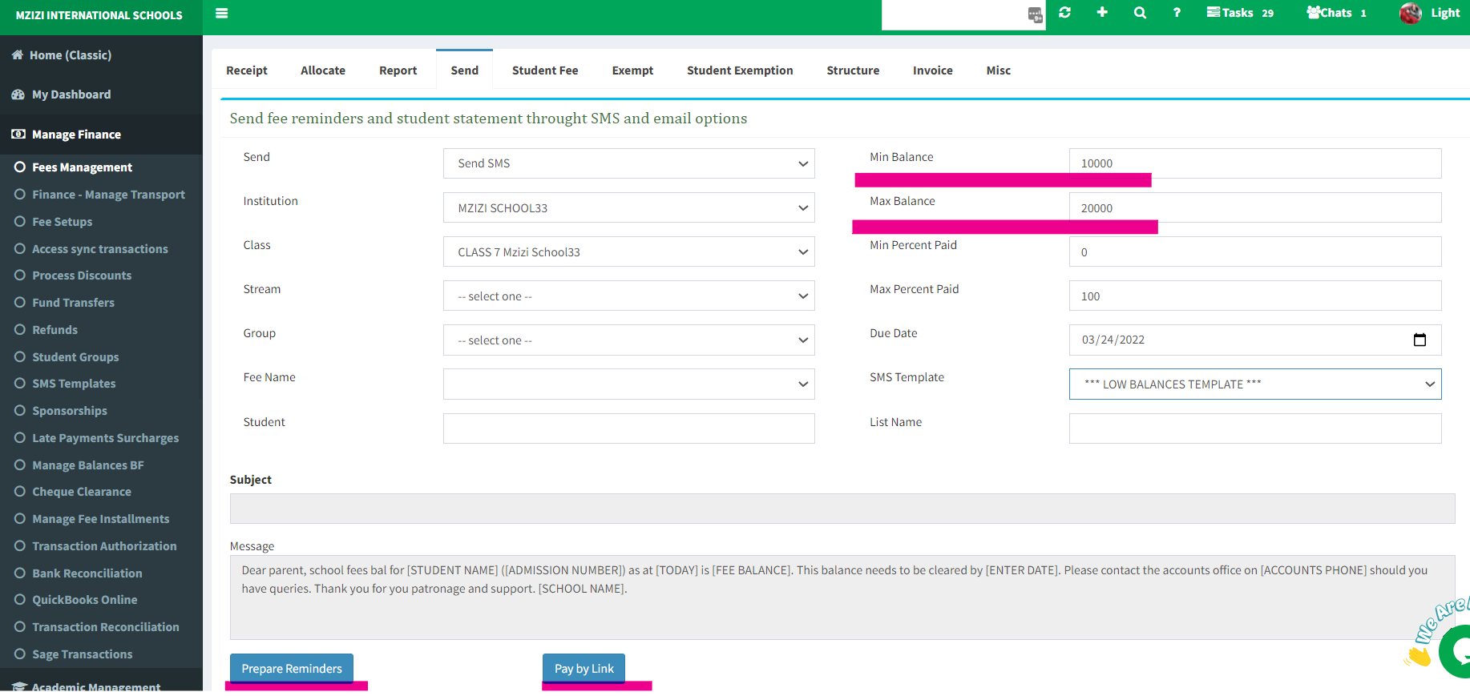
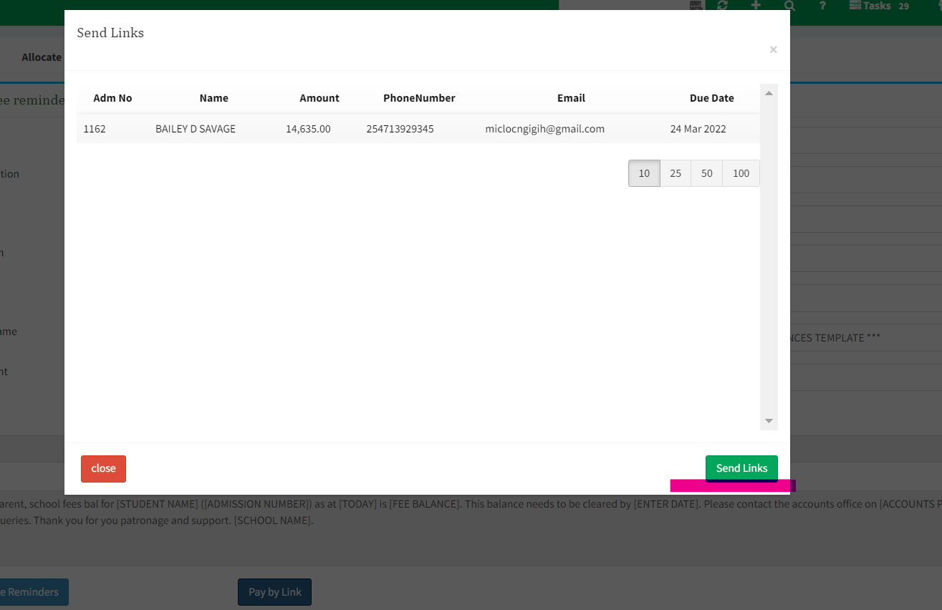
Pay By Link
Mzizi Finance Management provides the capability to send Invoices to Parents
Message send to contain a Pay link

Slide 13
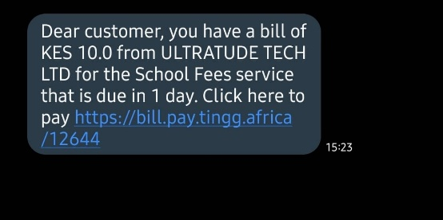
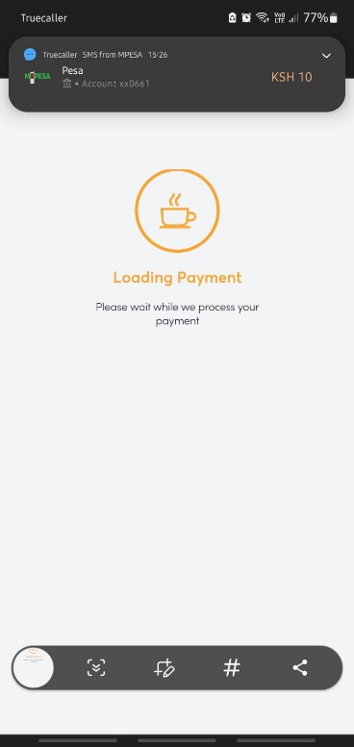
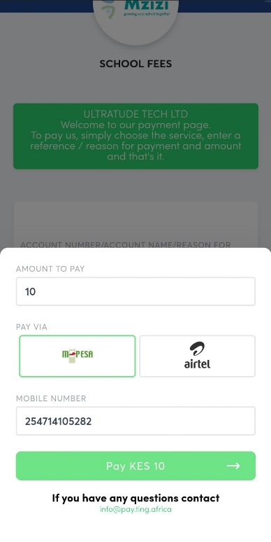
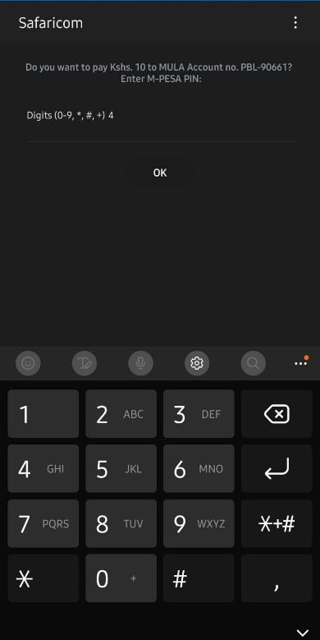
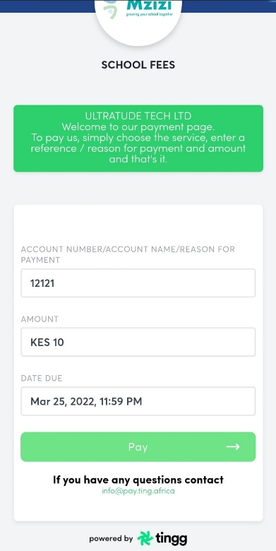
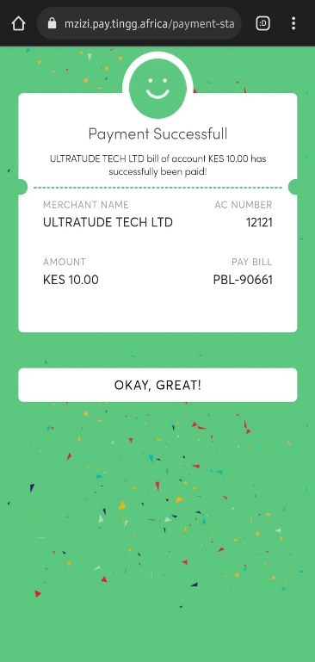
Pay By Link
Parent receives message from school
By parent clicking on the link the a payment checkout is initiated
Payment done and notified to Mzizi System for Receipt creation

Slide 14
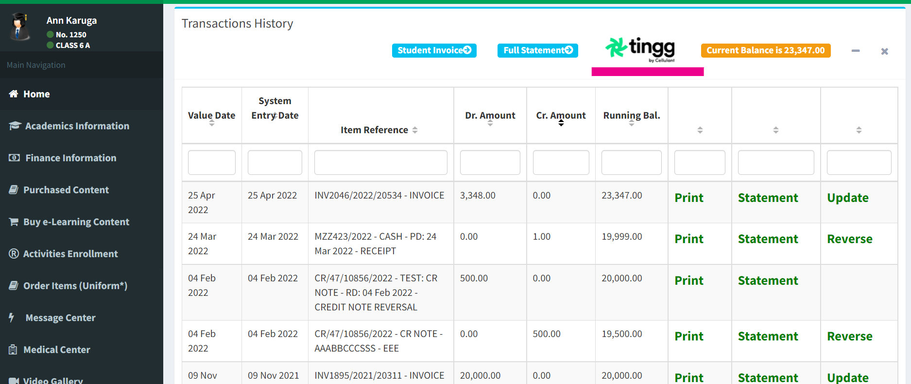
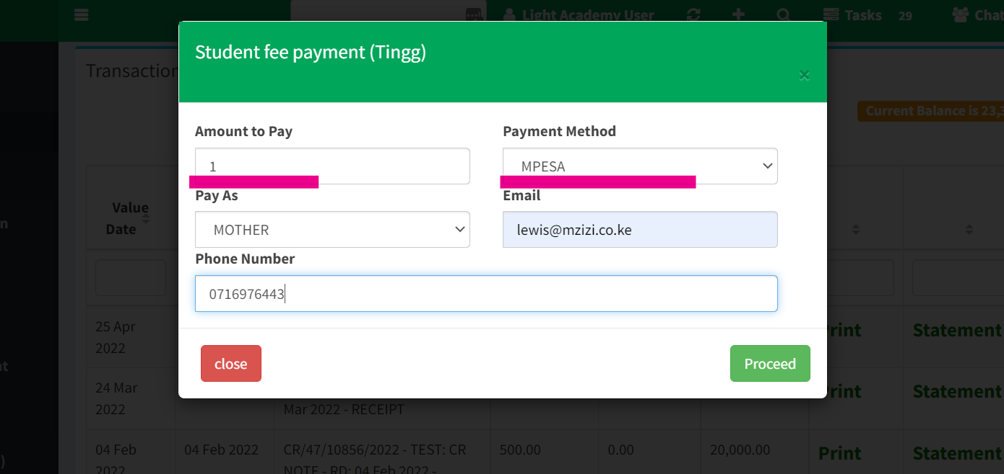
Checkout By Mobile and Web
Mzizi Parent portal provides outstanding balances with a tingg payment Option
On initiation of payment the parent specify the amount to pay and the payment mode

Slide 15
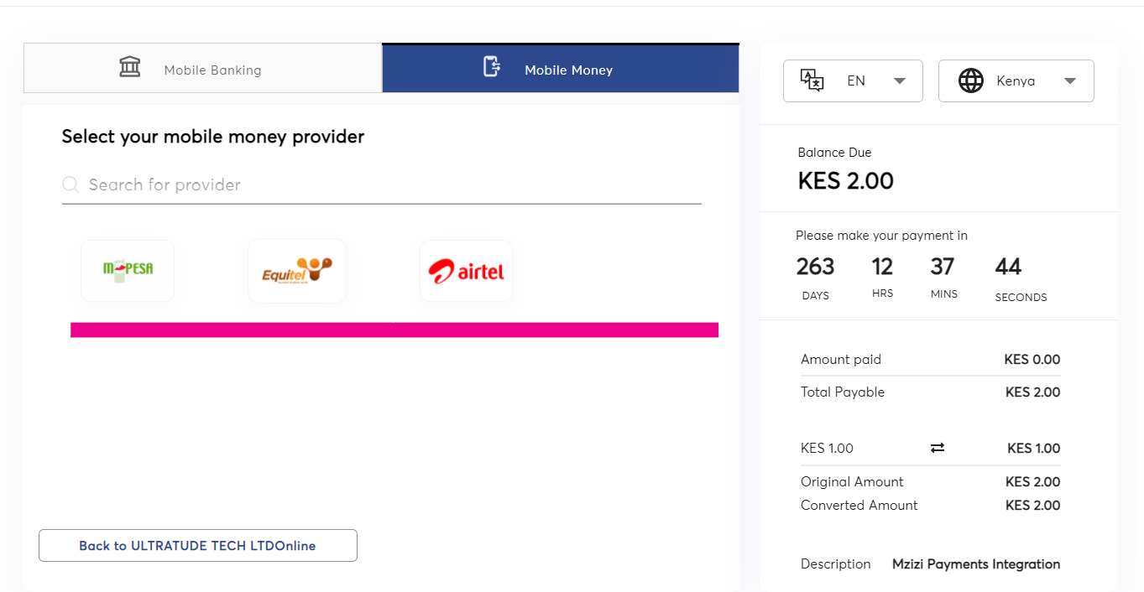
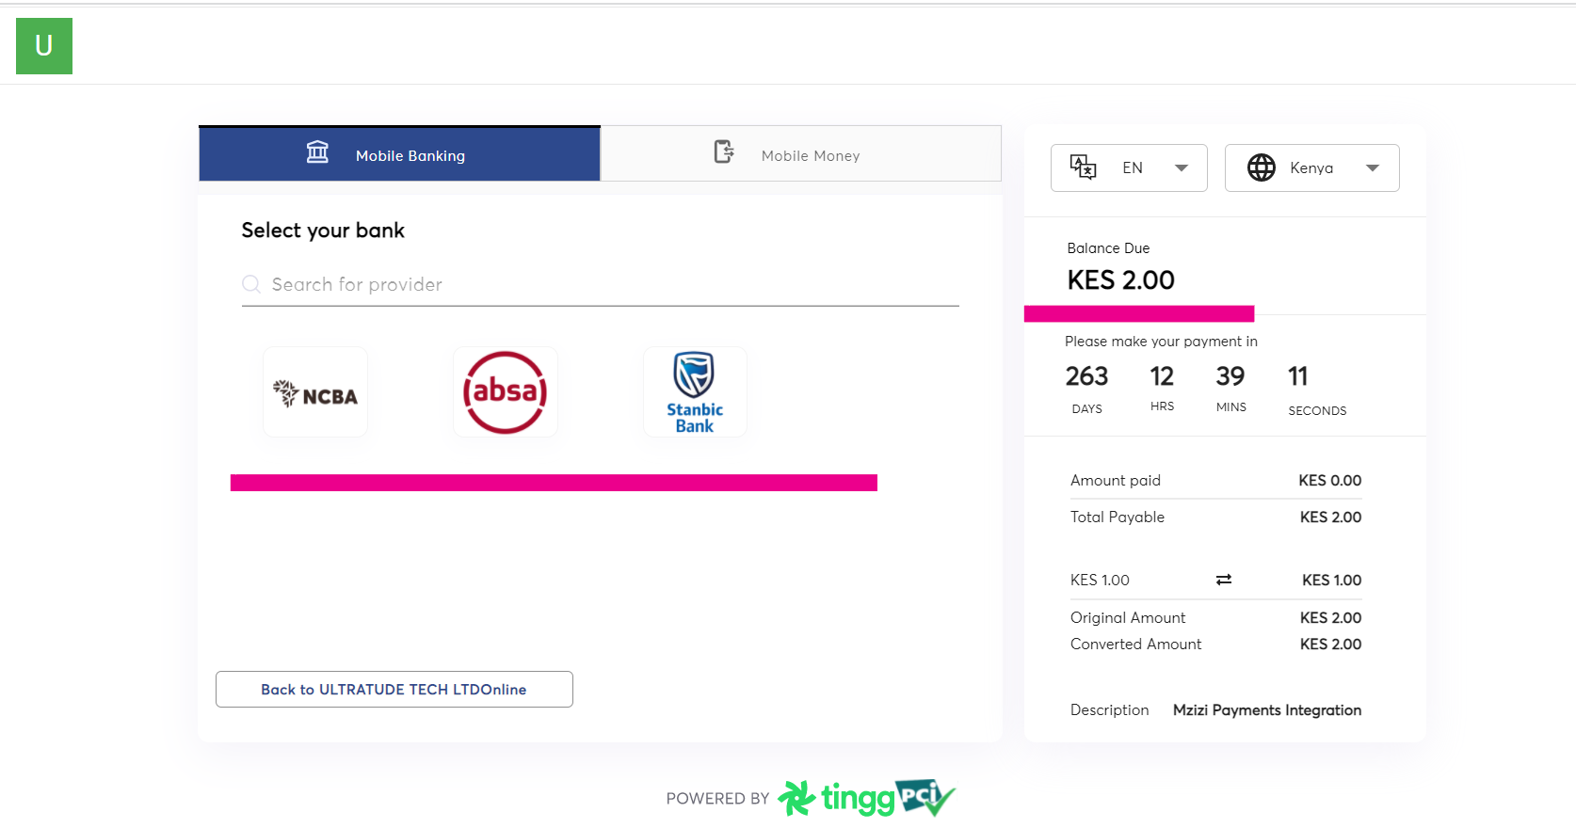
Checkout By Mobile and Web
Tingg Checkout provides two options Mobile Bank option and Mobile Money
On selection on the payment option system initiates the payment process

Slide 16
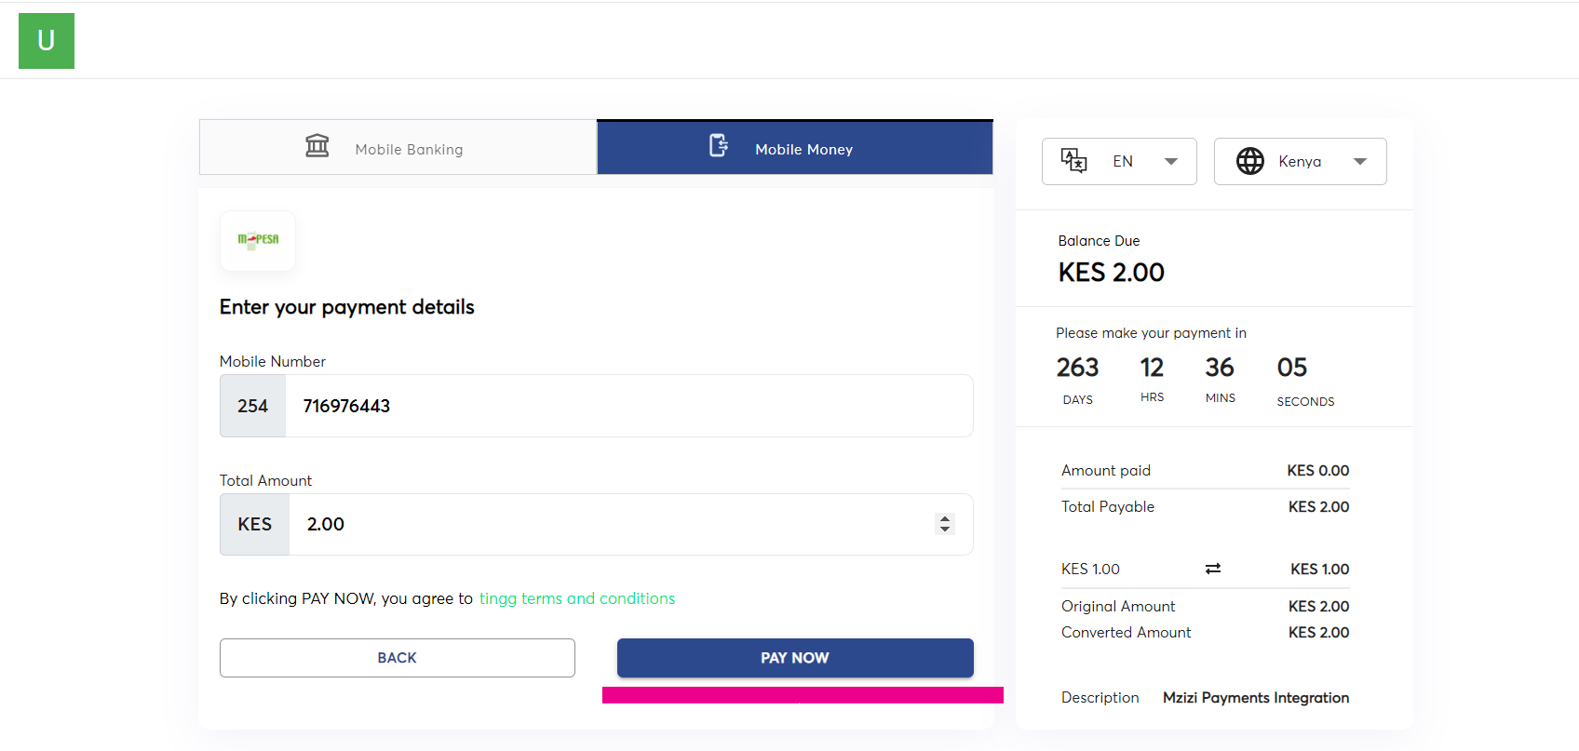
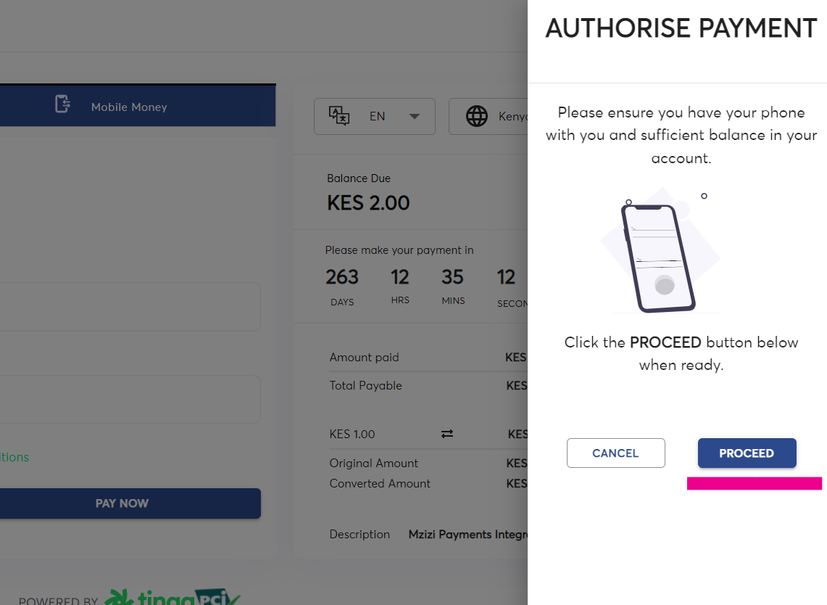
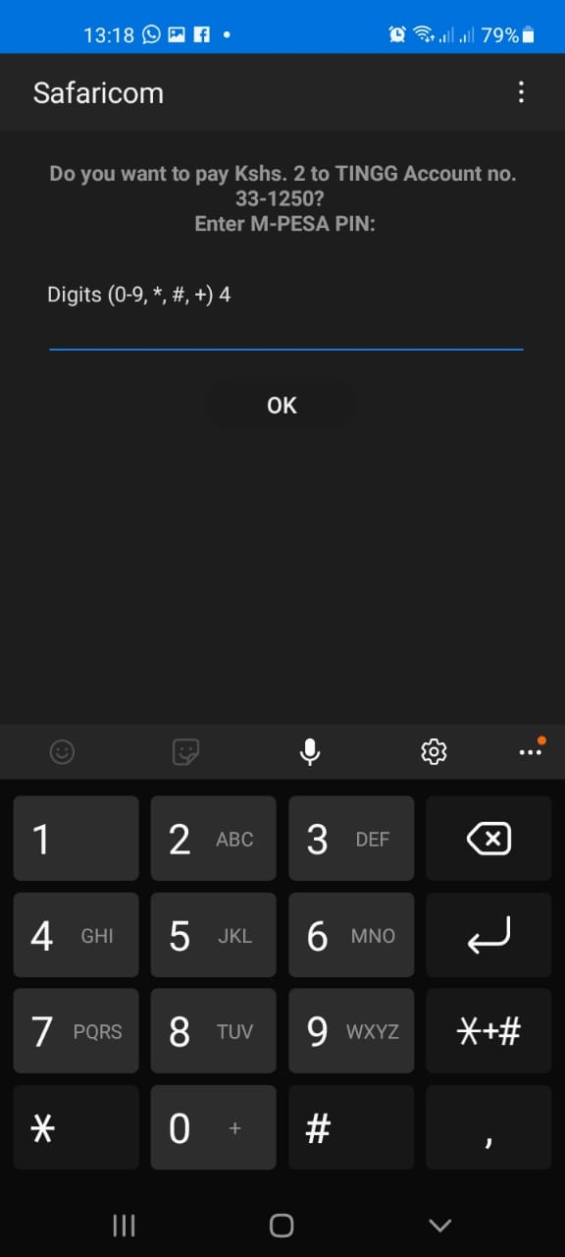
Checkout By Mobile and Web
Initiation of payment option with the Mobile Money as a sample Journey
System send a Pin capture option to parent

Slide 17
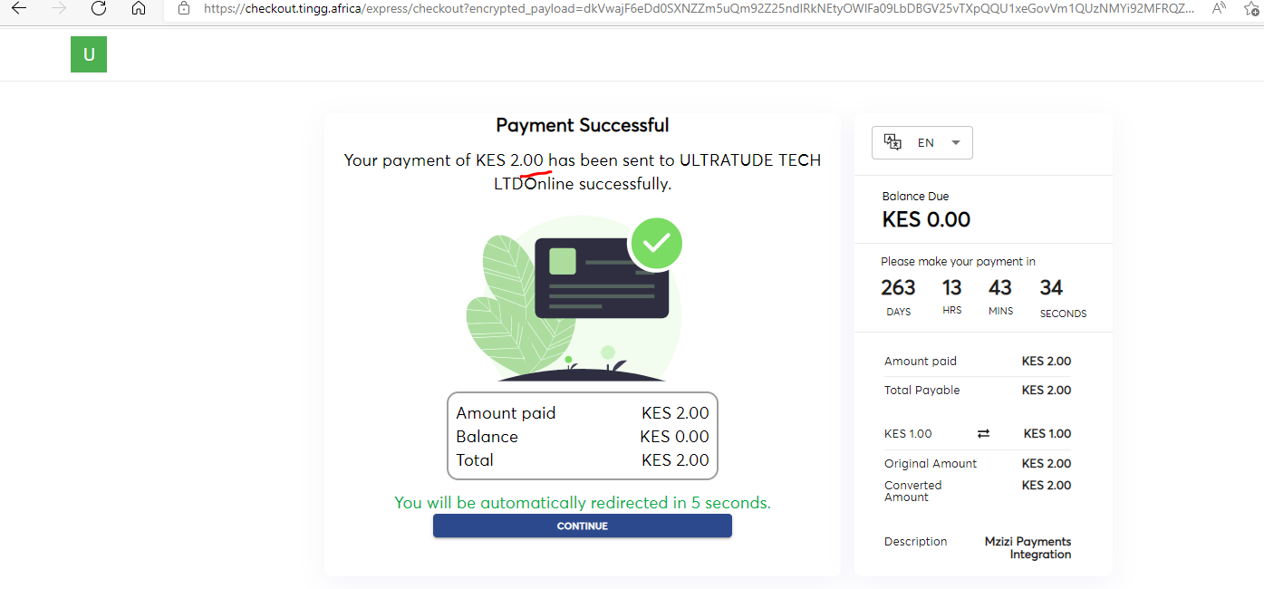
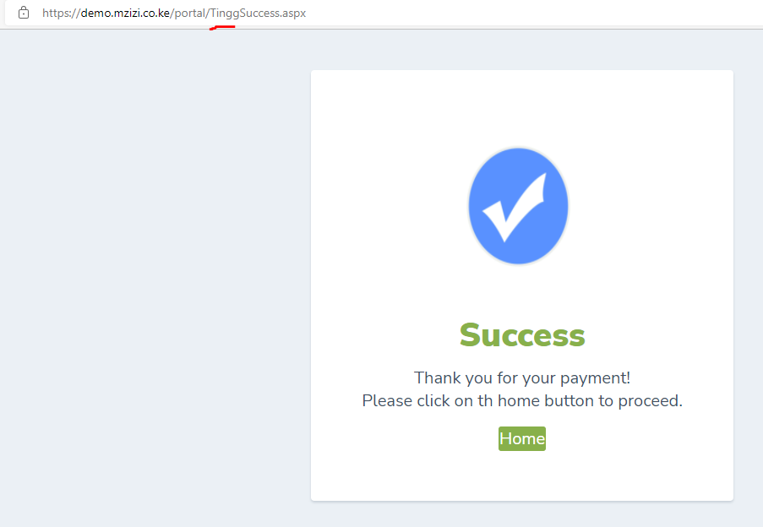
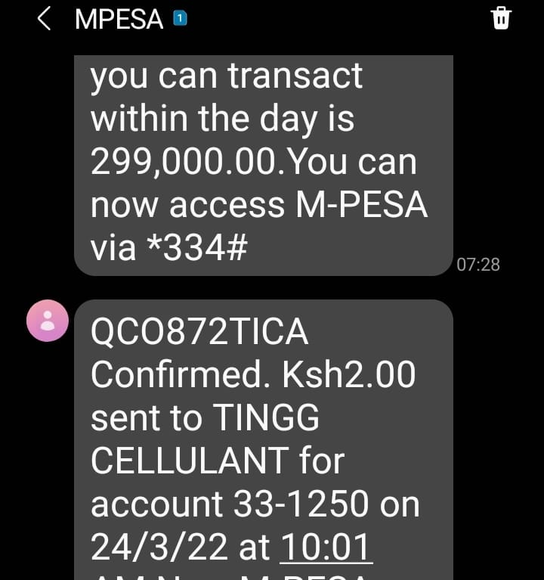
Checkout By Mobile and Web
Payment Confirmation is sent to Mzizi System

Slide 18
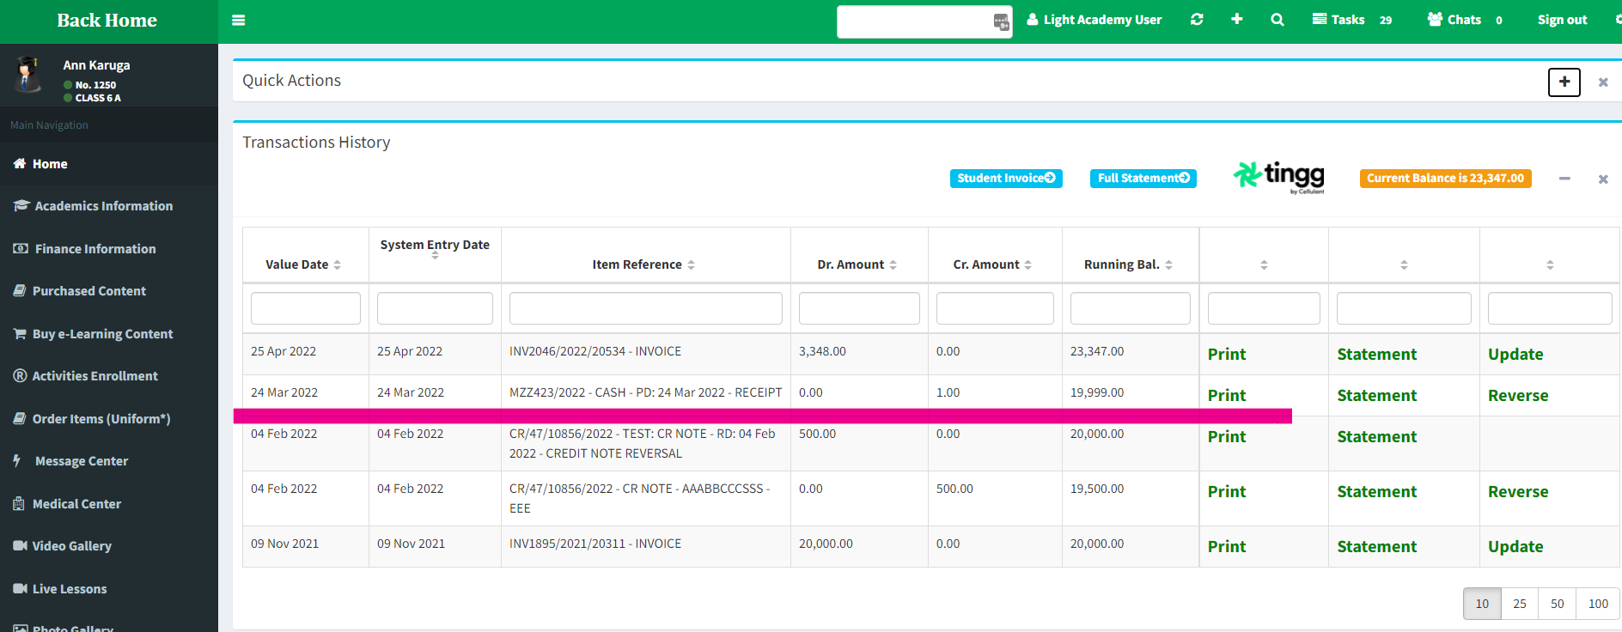
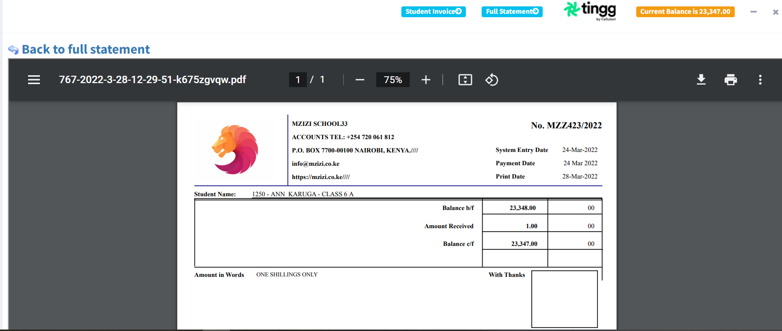
Checkout By Mobile and Web
Payment Confirmation is sent to Mzizi System
Parent can generate reports on system

Slide 19
REACH US
WEBSITE
EMAIL
ADDRESS
www.mzizi.co.ke
hello@mzizi.co.ke
Divyam Apartments Cedar Rd, Westlands
Lewis Njoroge
0716 976 443
lewis@mzizi.co.ke

